Slide 1
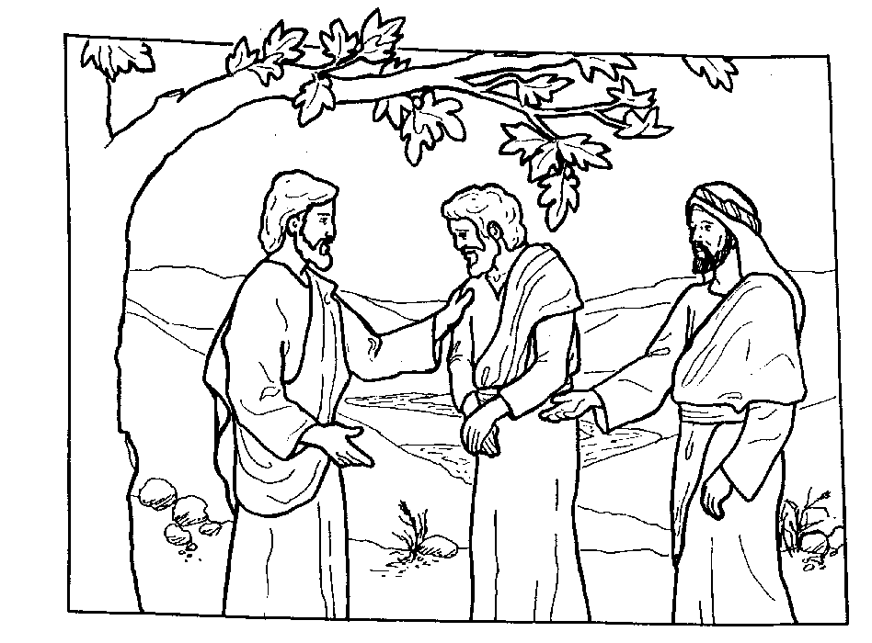
Kairos #45 Northeast Correctional Complex(NECX) SONS of THUNDER
James son of Zebedee and his brother John (to them he gave the name Boanerges, which means “sons of thunder”) Mark 3:17
April 24-27, 2025

